Slide 1

Week 06 Research Design Formulation
Masters of Information Systems & Technology
MIS 6220 RESEARCH METHODS
_{BY}
Prof. Jimmy K.N.Macharia,
Associate Professor of Information Systems &Technology, and
Dean, School of Science & Technology,
_{kmacharia@usiu.ac.ke}

Slide 2
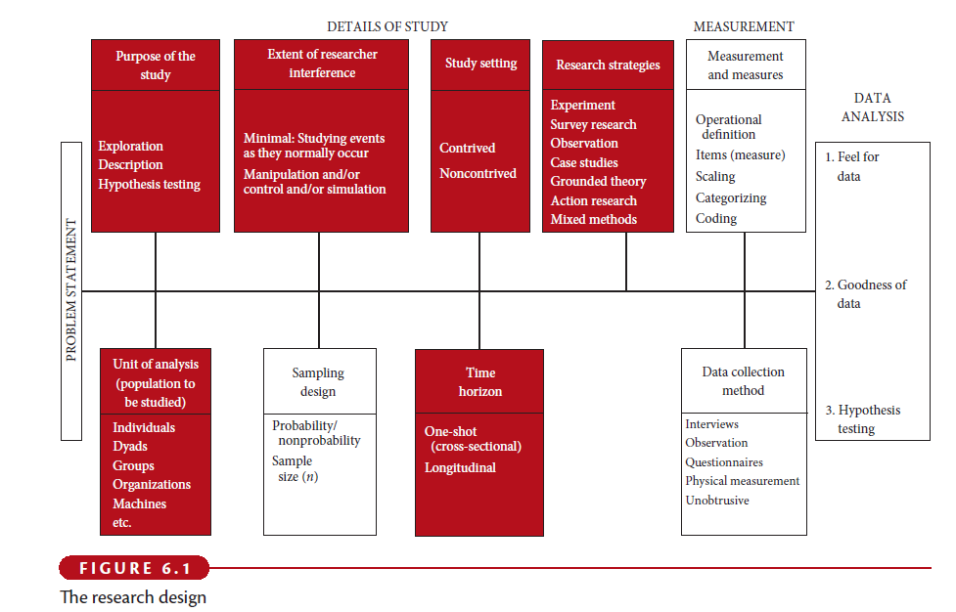
Research Design

Slide 3
Figure 3.1. Relationship of Research Design to the Previous Chapters and the Marketing Research Process
Focus of This
Chapter
Relationship to
Previous Chapters
Relationship to Marketing
Research Process
Problem Definition
Definition and Classification of Research Design
Exploratory Research Design
Descriptive Research Design
Causal Research Design
Marketing Research Process (Chapter 1)
Specification of the Information Needed (Chapter 2)
Approach to Problem
Research Design
Field Work
Data Preparation
and Analysis
Report Preparation and Presentation

Slide 4
Figure 3.2 Research Design: An Overview
Opening Vignette
Research Design Definition
Fig 3.3
Types of Basic Research Designs
What Would You Do?
Be a DM! Be an MR! Experiential Learning
Fig 3.4
Table 3.1
Exploratory Research
Table 3.2
Application to Contemporary Issues
International
Technology
Ethics

Slide 5
Figure 3.2 Research Design: An Overview (Cont.)
Opening Vignette
Descriptive Research
Figs 3.5 & 3.6
Table 3.3
Cross-Sectional
Longitudinal
Causal Research
What Would You Do?
Be a DM! Be an MR! Experiential Learning
Relationship Among Exploratory,
Descriptive, and Causal Research
Fig 3.7
Tasks Involved in Research Design Formulation
Fig 3.8
Application to Contemporary Issues
International
Technology
Ethics

Slide 6
Figure 3.2 Research Design: An Overview (continued)
Opening Vignette
Informational Value and the Cost of
Marketing Research
What Would You Do?
Be a DM! Be an MR! Experiential Learning
Budgeting and Scheduling the Project
Marketing Research Proposal
Application to Contemporary Issues (Fig. 3.9)
International
Technology
Ethics

Slide 7
Figure 3.3. Steps Leading to the Formulation of a Research Design
Define the Marketing Research Problem
Develop an Approach to the Problem
Formulate the Research Design

Slide 8
Purpose of the Study
Exploratory
Descriptive
Causal

Slide 9
Purpose of the Study
Exploratory study:
is undertaken when not much is known about the situation at hand, or no information is available on how similar problems or research issues have been solved in the past.
Example:
A service provider wants to know why his customers are switching to other service providers?

Slide 10
Purpose of the Study
Descriptive study:
is undertaken in order to ascertain and be able to describe the characteristics of the variables of interest in a situation.
Example:
A bank manager wants to have a profile of the individuals who have loan payments outstanding for 6 months and more. It would include details of their average age, earnings, nature of occupation, full-time/part-time employment status, and the like. This might help him to elicit further information or decide right away on the types of individuals who should be made ineligible for loans in the future.

Slide 11
Purpose of the Study
Causal study:
Delineating one or more factors that are causing the problem.
Example:
A marketing manager wants to know if the sales of the company will increase if he increases the advertising budget.

Slide 12
Extent of Researcher Interference
Minimal interference
Moderate interference
Excessive interference

Slide 13
Study Setting
Contrived: artificial setting
Non-contrived: the natural environment where work proceeds normally

Slide 14
Research Strategies
Experiments
Survey Research
Observation
Case studies
Grounded theory
Action research
Mixed Methods

Slide 15
Population to be studied
Unit of analysis:
Individuals
Dyads
Groups
Organizations
Cultures

Slide 16
Time Horizon
Cross-sectional studies
Snapshot of constructs at a single point in time
Use of representative sample
Multiple cross-sectional studies
Constructs measured at multiple points in time
Use of different sample
Longitudinal studies
Constructs measured at multiple points in time
Use of same sample = a true panel

Slide 17
Research Design: Definition
A research design is a framework or blueprint for conducting the marketing research project. It details the procedures necessary for obtaining the information needed to structure or solve marketing research problems.

Slide 18
Components of a Research Design
Define the information needed (Chapter 2)
Design the exploratory, descriptive, and/or causal phases of the research (Chapters 3 - 8)
Specify the measurement and scaling procedures (Chapters 9 and 10)
Construct and pretest a questionnaire (interviewing form) or an appropriate form for data collection (Chapter 11)
Specify the sampling process and sample size (Chapters 12 and 13)
Develop a plan of data analysis (Chapter 15)

Slide 19
Figure 3.4. A Classification of Market Research Designs
Research Design
Exploratory Research
Design
Conclusive Research
Design
Descriptive
Research
Causal Research
Cross-Sectional
Design
Longitudinal
Design

Slide 20
Table 3.1
Differences Between Exploratory and Conclusive Research
 | Exploratory | Conclusive
Objective: | To provide insights and understanding. | To test specific hypotheses and examine relationships.
Characteristics: | Information needed is defined only loosely. | Information needed is clearly defined.
 | Research process is flexible and unstructured. | Research process is formal and structured.
 | Sample is small and nonrepresentative | Sample is large and representative.
 | Data analysis is qualitative. | Data analysis is quantitative.

Slide 21
Table 3.1 (Cont.)
Differences Between Exploratory and Conclusive Research
 | Exploratory | Conclusive
Findings: | Tentative. | Conclusive.
Outcome: | Generally followed by further exploratory or conclusive research. | Findings used as input into decision making.

Slide 22
Table 3.2
A Comparison of Basic Research Designs
 | Exploratory | Descriptive | Causal
Objective: | Discovery of ideas and insights. | Describe market characteristics or functions. | Determine cause and effect relationships.
Character-istics: | Flexible. Versatile. Often the front end of total research design. | Marked by the prior formulation of specific hypotheses. Preplanned and structured design. | Manipulation of one or more independent variables. Control of other mediating variables.

Slide 23
Table 3.2 (Cont.)
A Comparison of Basic Research Designs
 | Exploratory | Descriptive | Causal
Method: | Expert surveys. Pilot surveys. Case studies. Secondary data (qualitative). Qualitative Research. | Secondary data (quantitative). Surveys. Panels. Observational and other data. | Experiments.

Slide 24
Uses of Exploratory Research
Formulate a problem or define a problem more precisely
Identify alternative courses of action
Develop hypotheses
Isolate key variables and relationships for further examination
Gain insights for developing an approach to the problem
Establish priorities for further research

Slide 25
Methods of Exploratory Research
Survey of experts (discussed in Chapter 2)
Pilot surveys (discussed in Chapter 2)
Secondary data analyzed in a qualitative way (discussed in Chapter 4)
Qualitative research (discussed in Chapter 5)

Slide 26
Use of Descriptive Research
To describe the characteristics of relevant groups, such as consumers, salespeople, organizations, or market areas
To estimate the percentage of units in a specified population exhibiting a certain behavior
To determine the perceptions of product characteristics
To determine the degree to which marketing variables are associated
To make specific predictions

Slide 27
Methods of Descriptive Research
Secondary data analyzed in a quantitative as opposed to a qualitative manner (discussed in Chapters 4 and 5)
Surveys (Chapter 7)
Panels (Chapters 5 and 7)
Observational and other data (Chapter 7)

Slide 28
Figure 3.5. Major Types of Descriptive Studies
Descriptive
Studies
Sales Studies
Consumer Perception
And Behavior Studies
Image
Product Usage
Advertising
Pricing
Market
Characteristic
Studies
Distribution
Competitive
Analysis
Market Potential
Market Share
Sales Analysis

Slide 29
Cross-sectional and Longitudinal Designs
A cross-sectional design involves the collection of information from any given sample of population elements only once.
In a longitudinal design, a fixed sample (or samples) of population elements is measured repeatedly on the same variables.
A longitudinal design differs from a cross-sectional design in that the sample or samples remain the same over time.

Slide 30
Figure 3.6 Cross Sectional vs. Longitudinal Designs
Figure 3.6. Cross-Sectional vs. Longitudinal Designs
Sample Surveyed at T₁
Cross- Sectional Design
Same Sample also Surveyed at T₂
Sample Surveyed at T₁
Longitudinal Design
Time
T₁
T₂

Slide 31
Table 3.3
Relative Advantages and Disadvantages of Longitudinal and
Cross-Sectional Designs
Evaluation Criteria | Cross-Sectional Design | Longitudinal Design
Detecting change | - | +
Large amount of data collection | - | +
Accuracy | - | +
Representative sampling | + | -
Response bias | + | -
Note: A + indicates a relative advantage over the other design whereas
a - indicates a relative disadvantage.

Slide 32
Uses of Casual Research
To understand which variables are the cause (independent variables) and which variables are the effect (dependent variables) of a phenomenon
To determine the nature of the relationship between the causal variables and the effect to be predicted
METHOD: Experiments

Slide 33
Figure 3.7. Some Alternative Research Designs
Exploratory
Research
Secondary Data Analysis
Focus Groups
Conclusive Research
Descriptive/Causal
(a)
Conclusive Research
Descriptive/Causal
(b)
Exploratory Research
Secondary Data Analysis
Focus Groups
Conclusive Research
Descriptive/Causal
(c)

Slide 34
Figure 3.8. Tasks Involved In a Research Design
Define the Information Needed
Design the Exploratory, Descriptive, and/or Causal Phases of the Research
Specify the Measurement and Scaling Procedures
Construct a Questionnaire
Specify the Sampling Process and the Sample Size
Develop a Plan of Data Analysis

Slide 35
